Slide 1
Detecting Movement in an Array Network Using a Semi-Supervised Localization Method and MRFs

Slide 2



Introduction

Slide 3
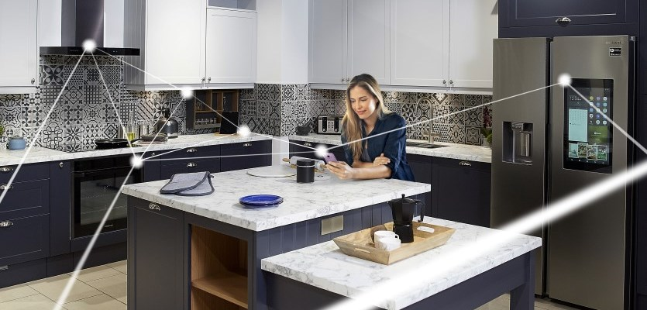
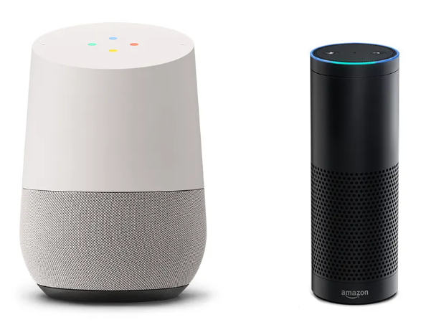
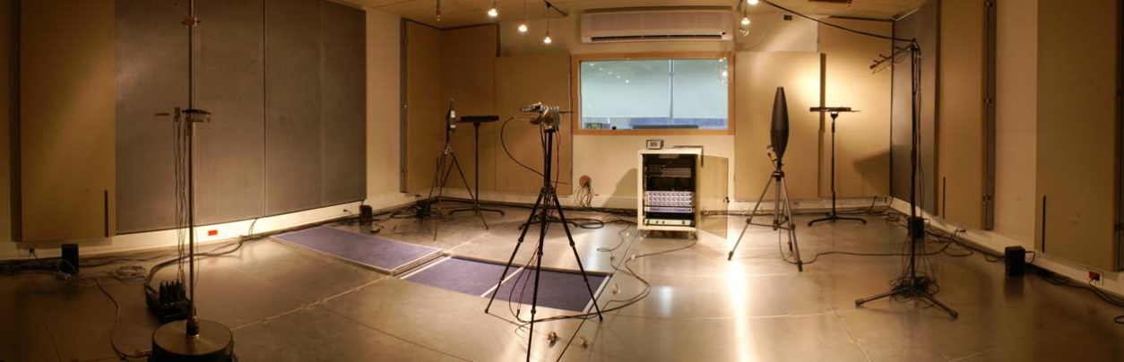

Project Background
https://degeekit.ie/google-home-vs-amazon-echo-in-ireland/
https://www.eng.biu.ac.il/gannot/files/2012/05/image017.jpg
https://energyefficientsmart.com/5-ways-to-make-your-smart-home-more-energy-and-cost-efficient/
https://www.nytimes.com/wirecutter/blog/amazon-echo-dot-vs-google-home-mini/

Slide 4
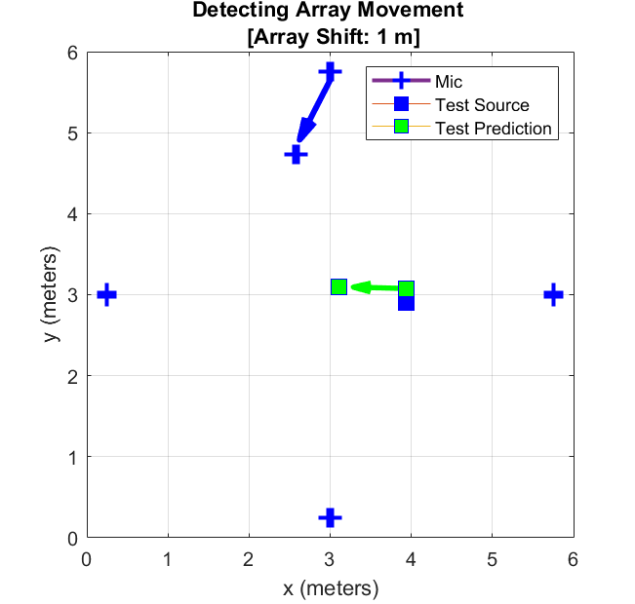
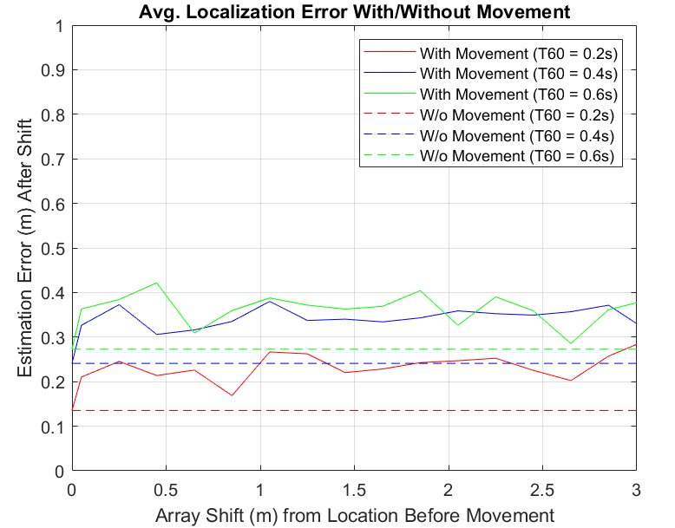
Motivation

Slide 5
Outline
Motivation
Semi-Supervised Gaussian Process (SSGP) Source Localization Method
Misalignment Detection Using Markov Random Fields (MRFs)
Results
Conclusion

Slide 6
Goals
Long-term goal: localize a source even if a microphone node is moved.
Salvage training data (if estimation results are still good).
Otherwise, consistently identify which array has moved.

Slide 7
SSGP source localization

Slide 8
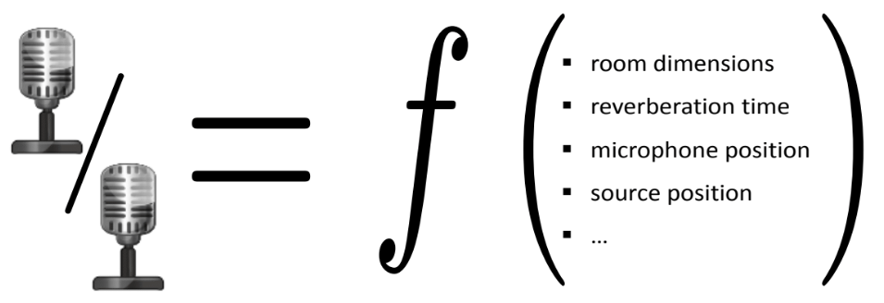
Relative Transfer Functions (RTFs)
Acoustic Transfer Function (ATF): precise model, but difficult to estimate [1,2,3].
RTF: represents the fingerprint for a given acoustic environment (easier to estimate).
Source positioning
T60
Mic positioning
Room dimensions
…
Source positioning
T60
Mic positioning
Room dimensions
…
Assumption: in smart-home environments, ATFs and RTFs depend on a small number of variables.
https://www.eng.biu.ac.il/gannot/tutorials-and-keynote-addresses/

Slide 9

Acoustic Impulse Response (AIR) and ATFs
u_{m,1}(t)
y_{m,1}(t)
a_{m,1}(t,p)
+
x(t))
*
a_{m,2}(t,p)
p(t)
+
y_{m,2}(t)
u_{m,2}(t)
Y_{m,1}(t,k) = A_{m,1}(t,k,p)X(t,k) + U_{m,1}(t,k)
Y_{m,2}(t,k) = A_{m,2}(t,k,p)X(t,k) + U_{m,2}(t,k)

Slide 10



Relative Impulse Response and RTFs
u_{m,1}(t)
y_{m,1}(t)
a_{m,1}(t,p)
+
x(t))
h_{m}$\text{(}\text{t}\text{,}\text{p}\text{)}$= $\frac{\text{a}\text{m}\text{,2}\text{(}\text{t}\text{,} \text{p}\text{)}}{\text{a}\text{m}\text{,1}\text{(}\text{t}\text{,} \text{p}\text{)}}$
*
a_{m,2}(t,p)
p(t)
+
y_{m,2}(t)
u_{m,2}(t)
H_{m}$\text{(}\text{t}\text{,}\text{k}\text{,}\text{p}\text{)}$ - RTF
$\text{S}\text{y}\text{1,}\text{y}\text{1(}\text{t}\text{,}\text{k}\text{)}$ – PSD.
$\text{S}\text{y}\text{2}\text{,}\text{y}\text{1}\text{(}\text{t}\text{,}\text{k}\text{)}$ – Cross PSD.
H_{m}$\text{(}\text{t}\text{,}\text{k}\text{,}\text{p}\text{)}$= $\frac{\text{A}\text{m}\text{,2}\text{(}\text{t}\text{,}\text{k}\text{,}\text{p}\text{)}}{\text{A}\text{m}\text{,1}\text{(}\text{t}\text{,}\text{k}\text{,}\text{p}\text{)}}$ ≈ $\frac{\text{S}\text{y}\text{2,}\text{y}\text{1(}\text{t}\text{,}\text{k}\text{)}}{\text{S}\text{y}\text{1,}\text{y}\text{1(}\text{t}\text{,}\text{k}\text{)}}$

Slide 11
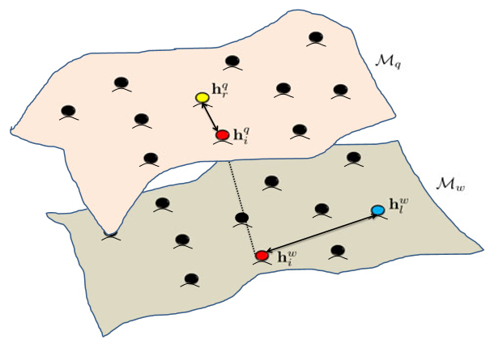
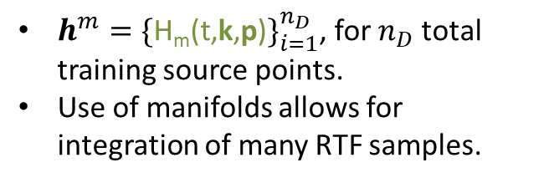
Semi-Supervised Gaussian Processes on Multiple Manifolds
SSGP uses RTFs to infer the position of an unknown source [2].
$h^{m}={\{\text{H}\text{m}\text{(}\text{t}\text{,}\text{k}\text{,}\text{p}\text{)}\}}_{i=1}^{n_{D}}$, for $n_{D}$ total training source points.
Use of manifolds allows for integration of many RTF samples.

Slide 12
SSGP (Cont.)
Semi-supervised: leverages both labelled and unlabelled data.
Labelled points act as an anchor.
Unlabelled points help interpolate over an area of interest.
Covariance matrix helps infer the position of an unknown source.

Slide 13
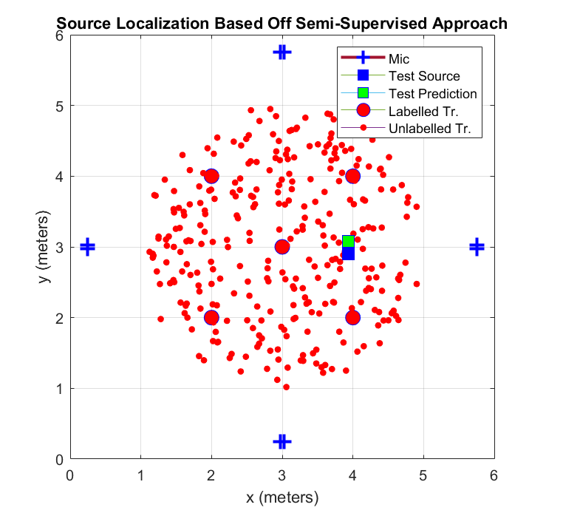
SSGP-Based Localization
Setup:
6m x 6m x 3m room.
4 nodes with 2 microphones per node.
5 labelled and 300 unlabelled training samples.
Speech files drawn at random from the Free ST American English Corpus [4].

Slide 14
Misalignment Detection using MRFs

Slide 15
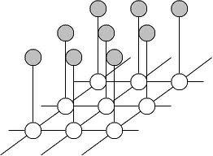
MRFs
Convenient and consistent way of modeling context dependent entities [5,6,7].
Goal: infer information regarding local neighborhoods of hidden nodes (i.e. cliques) that are potentially governed by different distributions.
Can be implemented in a local and massively parallel manner.

Slide 16
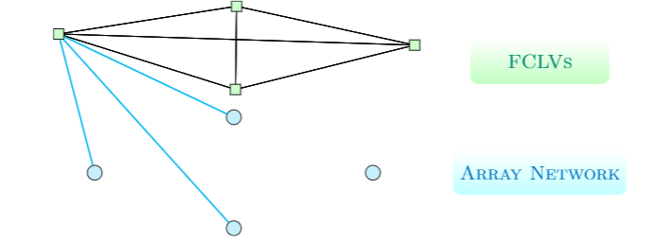
Misalignment Detection using MRFs
Utilize leave one node out (LONO) sub-networks to help infer which array is actually moving.
Each LONO estimates the source position, and inputs to the MRF the error in estimation.
Fully connected latent variables (FCLVs) imply that a given sub-network is either:
Aligned
Misaligned
Uncertain

Slide 17
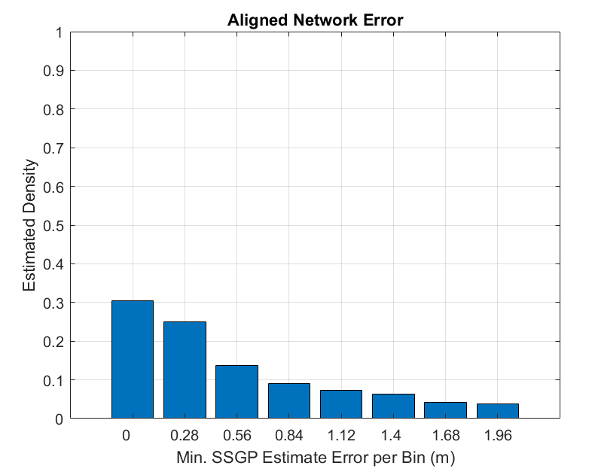
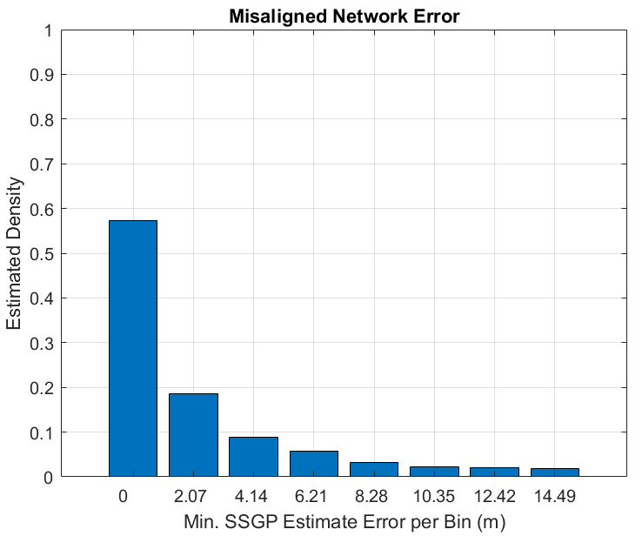
Latent Class Prior Distributions
Aligned case: normal distribution.
Misaligned case: exponential distribution
Parameter estimation involved simulating error for both cases with varying noise and T-60s.
Empirical outcomes inform prior distributions of the two latent classes.

Slide 18
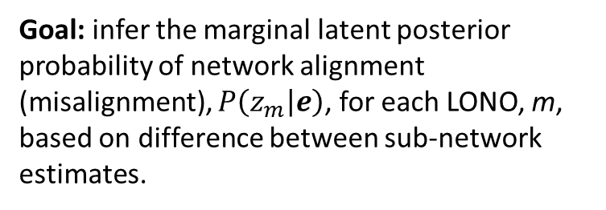
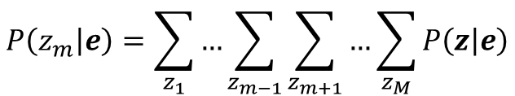
Latent Posterior Probability Estimation
Goal: infer the marginal latent posterior probability of network alignment (misalignment), $P\left(z_{m} | e\right)$, for each LONO, m, based on difference between sub-network estimates.
e_{m} – difference in a given LONO sub-network estimates.
z_{m} – latent variables (aligned, misaligned, uncertain).
$$P\left(z_{m} | e\right)=\sum_{z_{1}}{…\sum_{z_{m−1}}{\sum_{z_{m+1}}{…\sum_{z_{M}}{P\left(z | e\right)}}}}$$

Slide 19
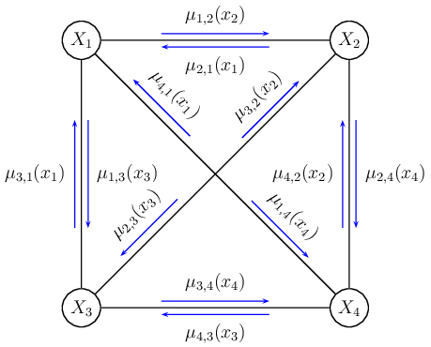
Message Passing Scheme
Belief propagation (BP): infers marginal posterior probabilities for Bayesian networks [8].
Loopy BP: approximate inference method applicable to any graphical model type [9].
Loopy BP follows local message passing schemes at each node and is applicable even in the presence of cycles.
μ_{i,j} – messages with information regarding the latent class priors and observed data passed from LONO i to j.

Slide 20
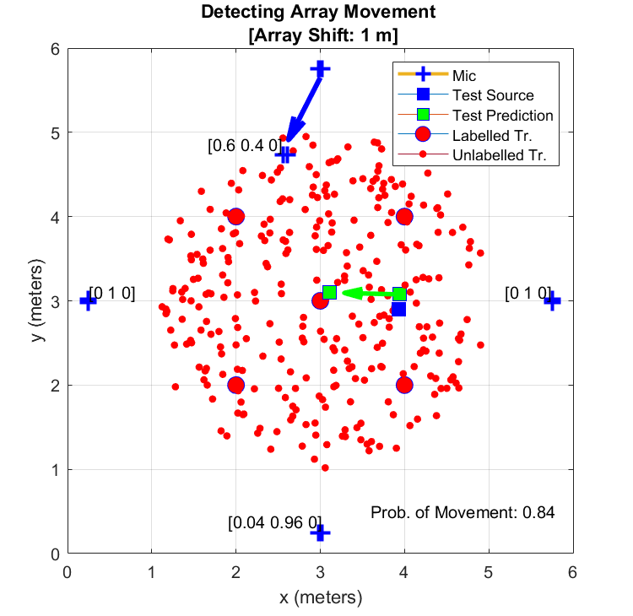
Misalignment Detection using Markov Random Fields
Labels, [a,b,c], denote latent state probabilities for each LONO sub-network.
Labelled node is the node left out.
LONO without the moving array should indicate alignment.

Slide 21
Results

Slide 22
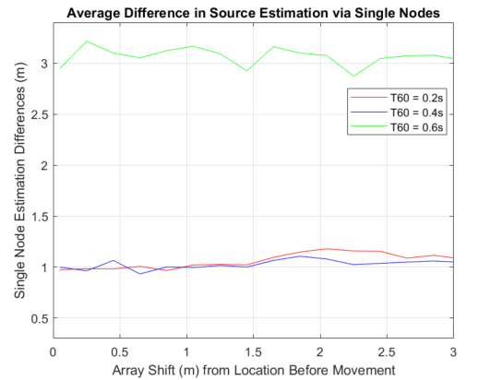
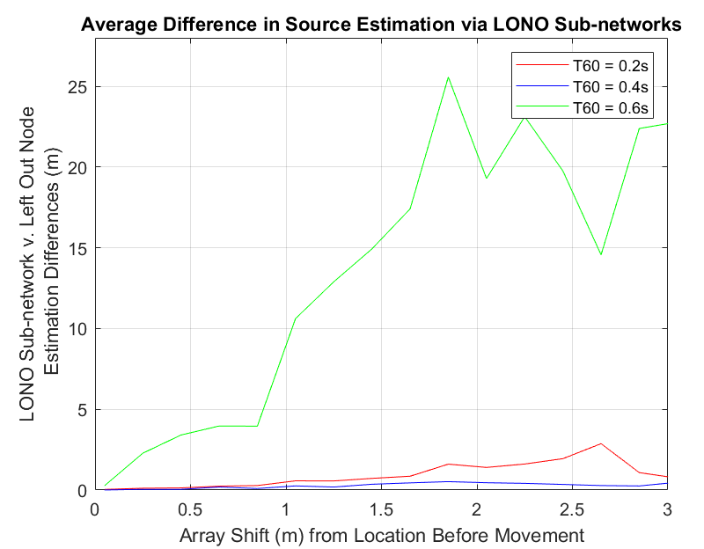
Naïve Comparison
Single node localization estimate comparison.
Error not well correlated to shift.
LONO estimate comparison (the input to the MRF model).
Estimate now correlated with shift but highly variable.

Slide 23
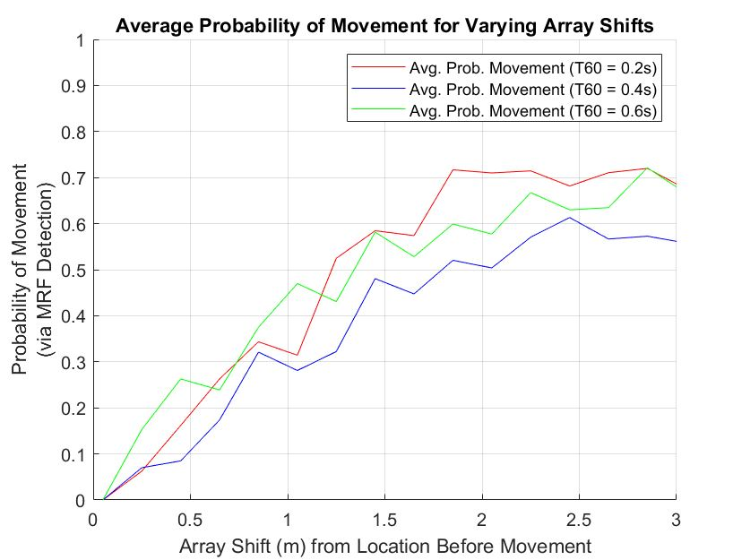
MRF Node Detection Results
Output is proportional to the size in shift.
Mostly independent to the level of reverberation.

Slide 24
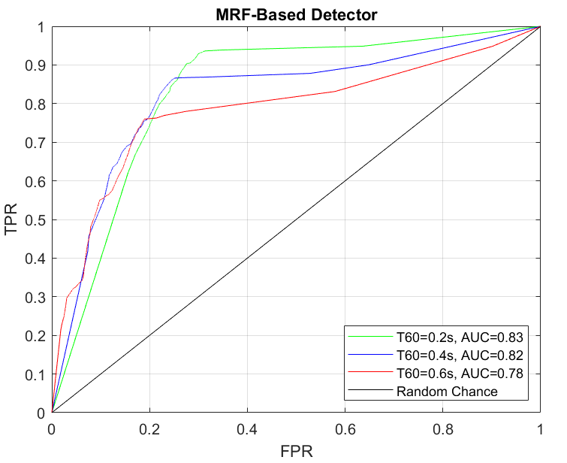
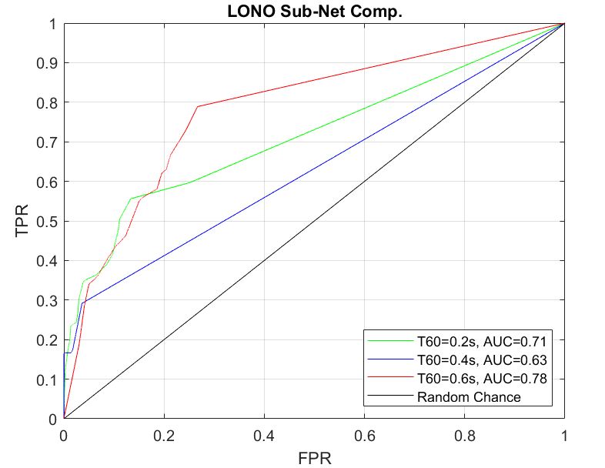
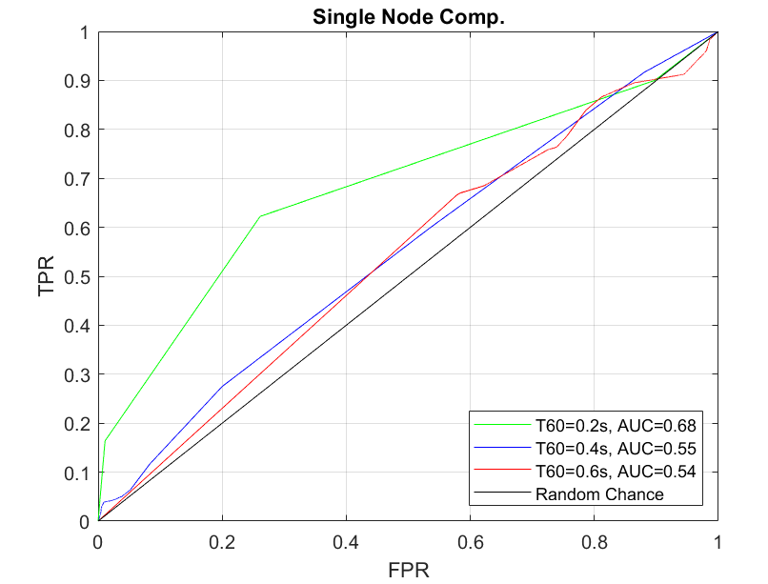
Results – ROC Curve
Sub-network estimate presents advantage to naïve single node estimate.
MRF-based detector shows clear advantage for different levels of reverberation.

Slide 25
Conclusions

Slide 26
Conclusions
Proposed an algorithm that probabilistically assesses whether a network of nodes is aligned.
Detects movement with a value that scales commensurate with the size of disruption in the network.
MRF model beneficial in comparison to naïve estimates that rely directly on positional estimation errors.

Slide 27
References
[1] Laufer-Goldshtein, B., Talmon, R., and Gannot, S. (2017). Speaker Tracking on Multiple-Manifolds with Distributed Microphones. LVA/ICA.
[2] Laufer-Goldshtein, B., Talmon, R., and Gannot, S. (2017). Semi-Supervised Source Localization on Multiple Manifolds With Distributed Microphones. IEEE/ACM Trans. Audio, Speech and Lang. Proc. 25, 7 (July 2017), 1477–1491.
[3] Talmon, R., Cohen, I. and Gannot, S. (2009). Relative Transfer Function Identification Using Convolutive Transfer Function Approximation. Trans. Audio, Speech and Lang. Proc. 17, 4 (May 2009), 546–555.
[4] ST-AEDS-20180100_1, Free ST American English Corpus
[5] Akai, N., Morales, Y., Hirayama, T. and Murase, H. (2019). Misalignment Recognition Using Markov Random Fields with Fully Connected Latent Variables for Detecting Localization Failures.
[6] Stan, L.Z. (2009). Markov Random Field Modeling in Image Analysis (3rd. ed.). Springer Publishing Company, Incorporated.
[7] Boykov, Y., Veksler, O. and Zabih, R. (1998). Markov Random Fields with Efficient Approximations. In Proceedings of the IEEE Computer Society Conference on Computer Vision and Pattern Recognition (CVPR ’98). IEEE Computer Society, USA, 648.
[8] Knoll, C., Rath, M., Tschiatschek, S. and Pernkopf, F. (2015). Message Scheduling Methods for Belief Propagation.
[9] Christopher M. Bishop (2006). Pattern Recognition and Machine Learning (Information Science and Statistics). Springer-Verlag, Berlin, Heidelberg.

Slide 28
Thank you

